Slide 1
Cyclistic Rider Trends: Casual vs Member Behavior
Leveraging Ride Data to Increase Membership
Author: Kent Ward
Date: April 17, 2025

Slide 2
Why This Matters
🎯Understand how members and casual riders use Cyclistic differently
🎯Inform marketing strategy to increase membership conversion
🎯Leverage data insights to inform targeted campaigns

Slide 3

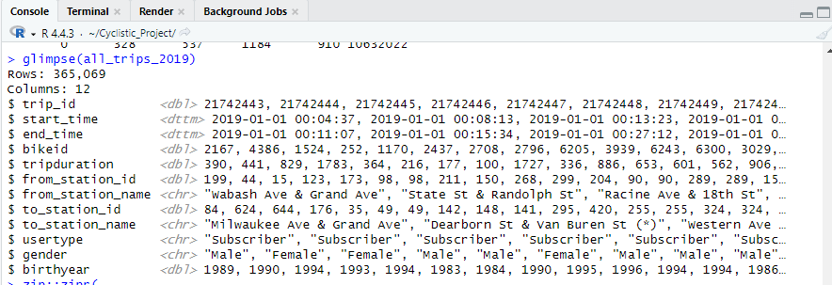
About the Data
790,000 total rides analyzed
Glimpse of 2019 Q1 Trip Data in RStudio

Slide 4
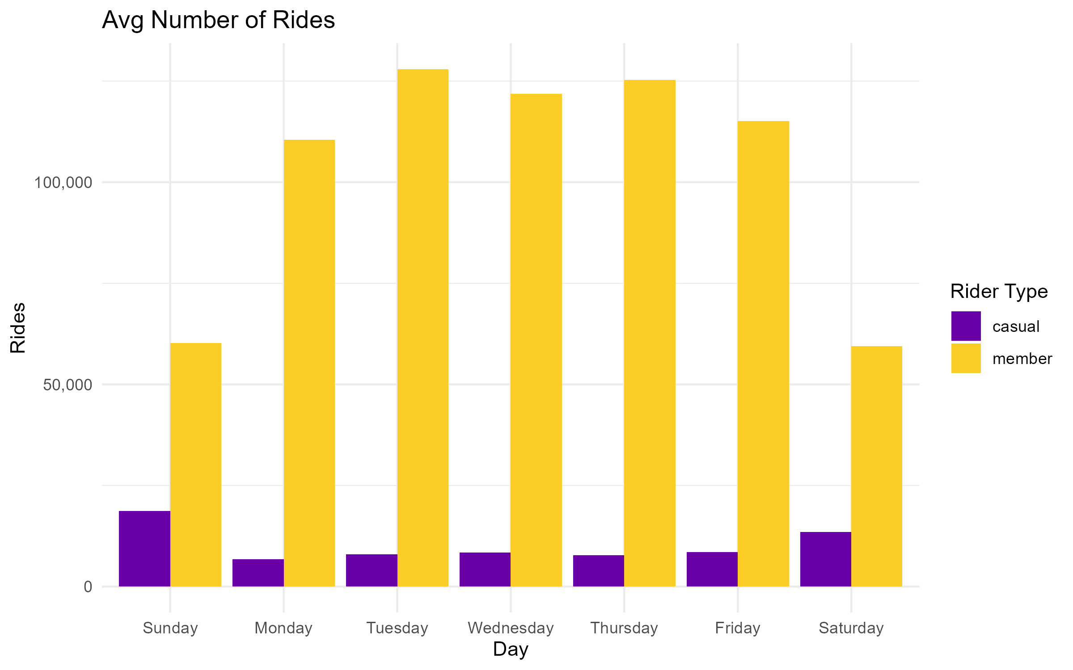
Ride Frequency Patterns
Members ride constantly throughout the week (weekday commuters)
Casuals ride mostly on weekends (leisure users)
Highest activity: Tuesday – Thursday (members), Sunday (casuals)

Slide 5
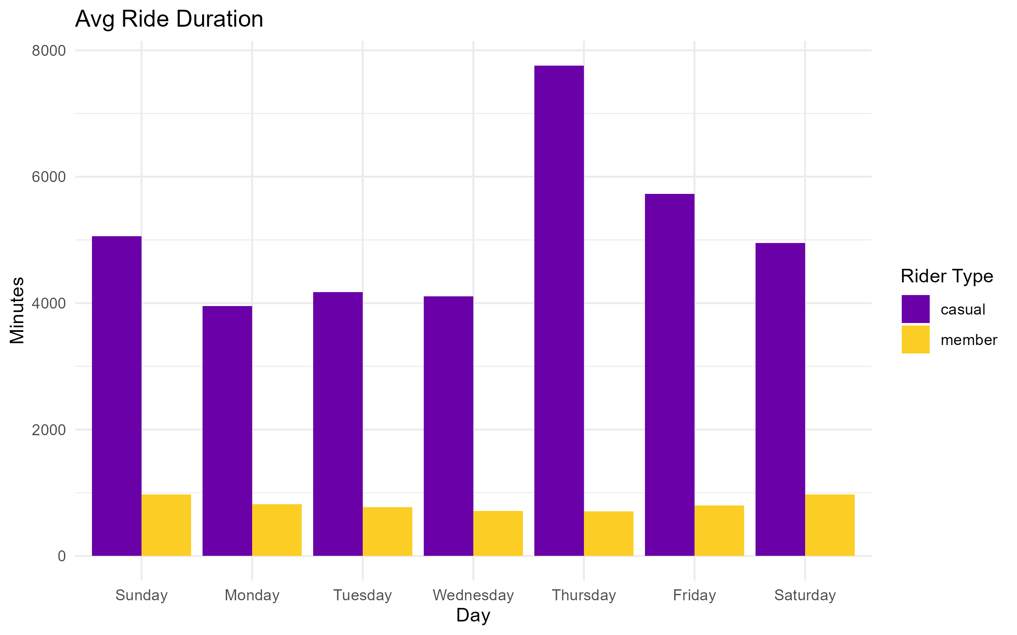
Ride Duration Trends
Casual riders take much longer trips on average
Members ride shorter, likely purposeful trips
Suggest that casuals are “exploring”, members are “commuting”

Slide 6
Member vs. Casual Rider Behavior
Casual Riders | Members
Weekend use | Weekday commuting
Longer Rides | Short, frequent trips
Leisure & flexibility | Efficiency & routine
Note: This behavior highlights opportunities to tailor marketing strategies based on ride purpose.

Slide 7
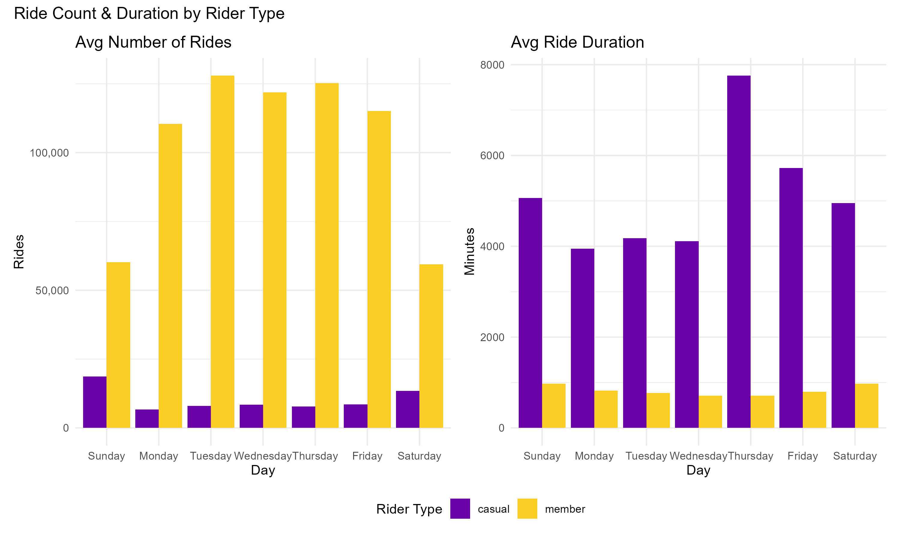
Ride Frequency and Duration: Side-by-Side Comparison
Notes:
This combined view reinforces our earlier insights. Casual riders spike on weekends with longer ride durations, while members ride more evenly across the week with shorter trips. This contrast presents an opportunity for targeted marketing strategies based on behavior patterns.

Slide 8
Turning Insights Into Action
1️⃣ Launch Weekend Promotions for Casual Riders
Increase casual engagement and introduce habit-forming use
2️⃣ Position Membership as a Weekday Convenience Tool
Market memberships as a faster, cost-effective way to commute or run errands
3️⃣ Target Behavior-Based Upsell Campaigns
Convert loyal casuals through contextual reminders
Notes:
#1: Why: Casual riders spike on weekends and ride longer Idea: Offer discounts, loyalty stamps, or “first weekend free” promotions to encourage repeat usage and nurture them into becoming members
#2: Why: Members ride frequently during weekdays and take shorter trips Idea: Market memberships as a faster, cost-effective way to commute or run errands
#3: Why: Ride behavior suggests distinct use cases for casual vs. members Idea: Use personalized campaigns like “You rode 3 weekends this month — save more with a membership” or app push notifications when casual ride count hits a threshold

Slide 9
Resources
Resource | Description | Link
HTML Report | Full Summary | Cyclistic Case Study
Visual Charts | Ride Count, Avg. Duration, Comparison | Cyclistic Visuals
Insight summary | 1-pager for stakeholders | PDF Summary
For questions, contact: Kent Ward | kent.ward@khembroward.com

Slide 10
Questions?

